Slide 1
James 5:13-20
13Is any one of you in trouble? He should pray. Is anyone happy? Let him sing songs of praise. 14Is any one of you sick? He should call the elders of the church to pray over him and anoint him with oil in the name of the Lord. 15And the prayer offered in faith will make the sick person well; the Lord will raise him up. If he has sinned, he will be forgiven. 16Therefore confess your sins to each other and pray for each other so that you may be healed. The prayer of a righteous man is powerful and effective.

Slide 2
James 5:13-20
17Elijah was a man just like us. He prayed earnestly that it would not rain, and it did not rain on the land for three and a half years. 18Again he prayed, and the heavens gave rain, and the earth produced its crops. 19My brothers, if one of you should wander from the truth and someone should bring him back, 20remember this: Whoever turns a sinner from the error of his way will save him from death and cover over a multitude of sins.

Slide 3
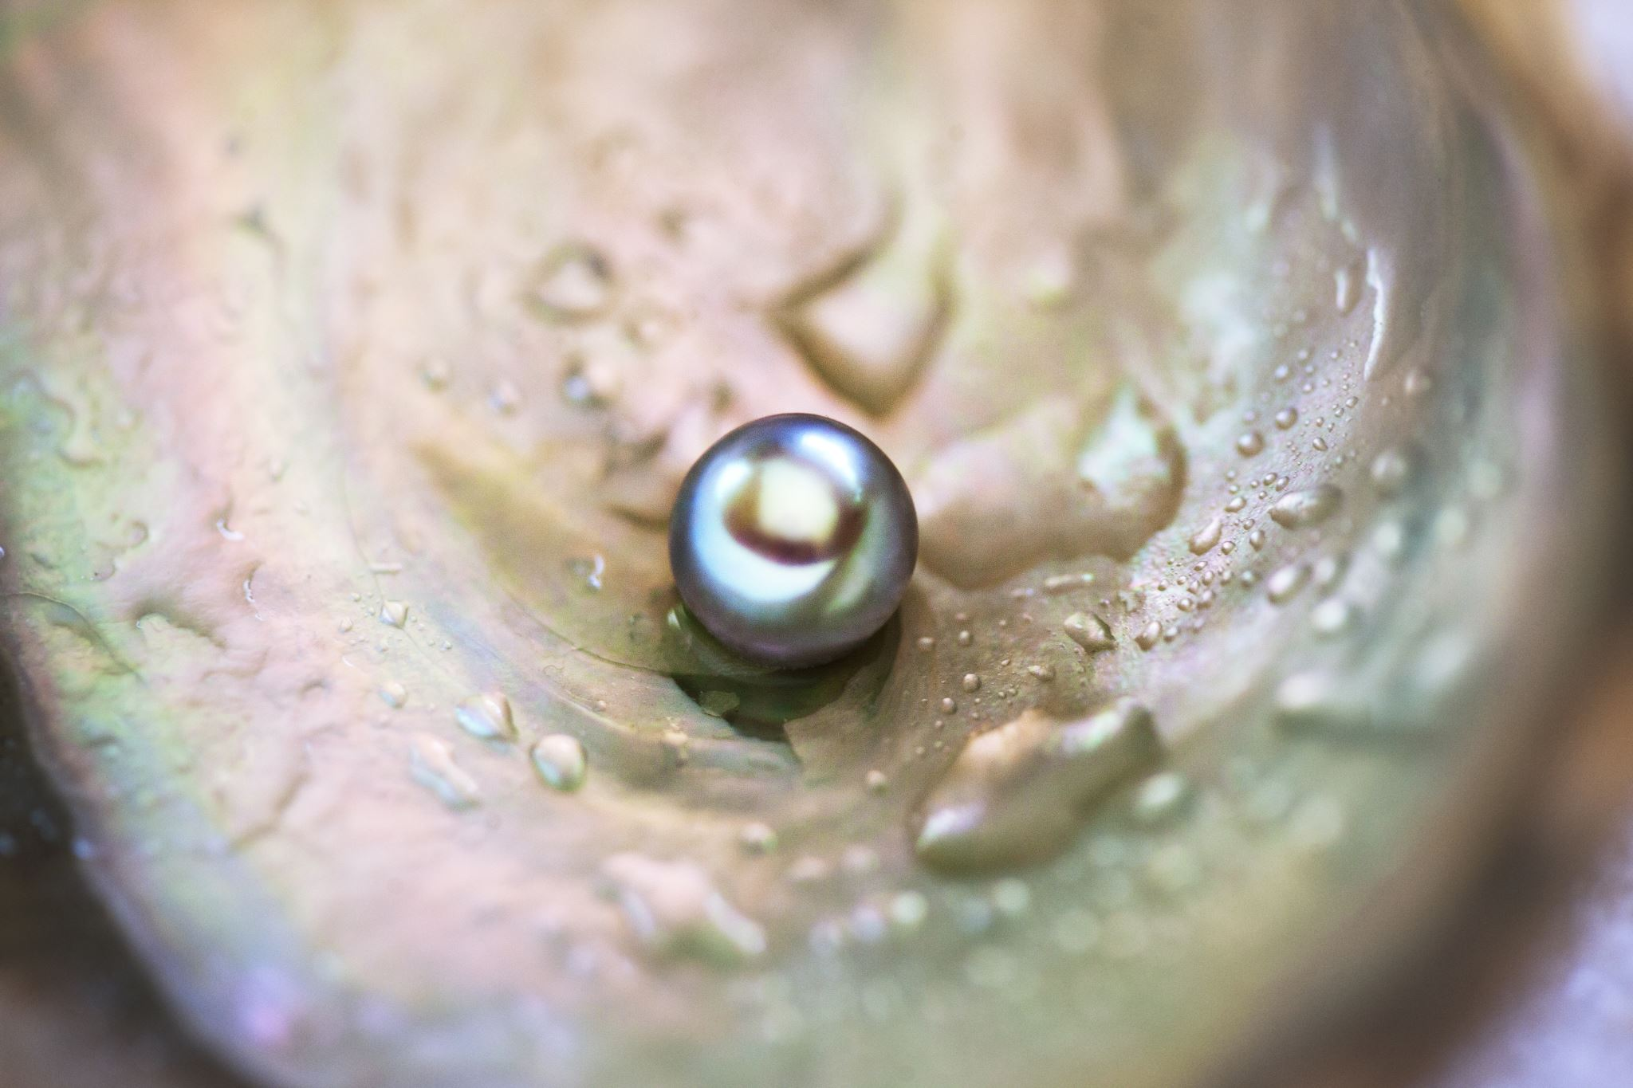
Pearls from James
September:
11th – Sue de Pyle – James 1:19-27
18th – Woody Baker – James 2:1-13
25th – Woody Baker– James 2:14-26
October:
2nd – Kay Brown – James 4:1-17
9th – Tania Hannath – James 3:1-12
16th – Tom Kenneally - James 3:13-18
23rd – Kay Brown – James 5:13-20

Slide 4
Pearls from James
September:
11th – Sue de Pyle – James 1:19-27
18th – Woody Baker – James 2:1-13
25th – Woody Baker– James 2:14-26
October:
2nd – Kay Brown – James 4:1-17
9th – Tania Hannath – James 3:1-12
16th – Tom Kenneally - James 3:13-18
23rd – Kay Brown – James 5:13-20
Listening and Doing
Favouritism
Faith and Deeds
Submitting to God
Boasting about tomorrow
Taming the tongue
Two types of wisdom
Prayer of faith

Slide 5
Pearls from James
October 23rd
Kay Brown
James 5:13-20
The Prayer of Faith

Slide 6
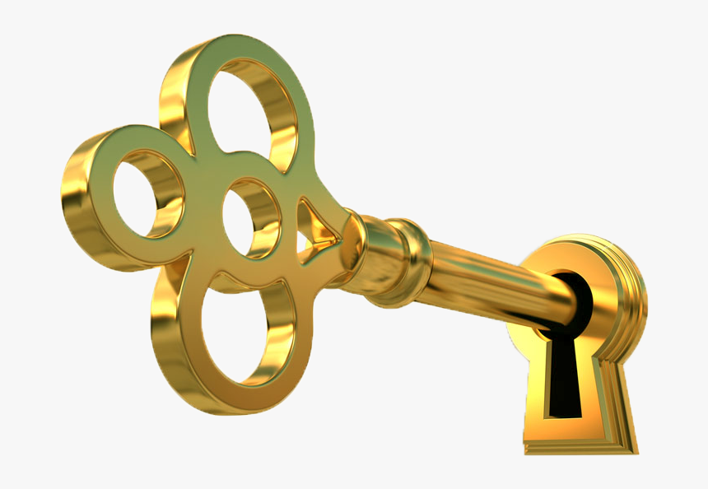
Pearls from James
October 23rd
Kay Brown
James 5:13-20
The Prayer of Faith
Prayer is a golden key that is kept bright by constant use and it will unlock the treasures of earth and heaven

Slide 7
Pearls from James
James 5:13-20
Pray when you are:
In trouble

Slide 8
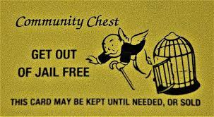
Pearls from James
James 5:13-20
Pray when you are:
In trouble

Slide 9
Pearls from James
James 5:13-20
Pray when you are:
In trouble
Happy – sing a song of praise

Slide 10
Pearls from James
James 5:13-20
Pray when you are:
In trouble
Happy – sing a song of praise
Join the Thrive Tribe
Journal 3 things that went well
each day and why, be grateful
Give thanks to God

Slide 11
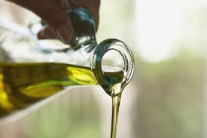
Pearls from James
James 5:13-20
Pray when you are:
In trouble
Happy – sing a song of praise
Sick – call the Elders

Slide 12
Pearls from James
James 5:13-20
Pray when you are:
In trouble
Happy – sing a song of praise
Sick – call the Elders
1 John 1:9
If we confess our sins, he is faithful and just and will forgive us our sins and purify us from all unrighteousness

Slide 13
Pearls from James
James 5:13-20
Pray when you are:
In trouble
Happy – sing a song of praise
Sick – call the Elders
Wronged someone – confess

Slide 14
Pearls from James
James 5:13-20
The prayer of a righteous man/woman is powerful
and effective
Elijah - 1 Kings 17-19 - just like us – ask for a miracle

Slide 15
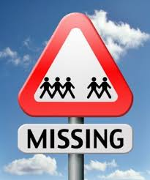
Pearls from James
James 5:13-20
Seek out a wayward brother/sister and
Turn them back to the truth
Relationship
Mercy never far away

Slide 16
Pearls from James
What area in your life has the Holy Spirit spoken to you about that needs to change?
How can you deepen your prayer life and time with God?
Who do you know that needs an encouraging word to point them back on track to Jesus?

